Slide 1
Team Project Assignment 2 Presentation
Eduard Iulian Airinei - 21300453
Andrea Bizzotto - 21289505
Robert Ciociu - 21282003
Ernest Prusevic - 21329716

Slide 2
Andrea (Team Leader & PHP Developer)
Ernest (SQL Developer)
PHP Developer
Database Connection
Extraction & elaboration Data
SQL Developer
Creation Tables
Creation Triggers
Creation ER Diagram
Robert (Web Designer & Developer)
Eduard (Presentation Developer)
Website Design
HTML
CSS
JS
Gann Chart
Presentation Structure
Presentation Developer

Slide 3
Development plan
Meetings
Reviewing each member's progress in accordance to the schedule.
Managing project tasks
Sharing progress made thus far, throughout the development of the project.
Providing project access to each group member.
Project Development
Documentation (Charts & Spreadsheets)
GitHub
Helping each individual for further progress.
Sharing additional ideas, providing advice among each other.
Work items and source control.
Presentation

Slide 4


Our project revolves around creating a phone website that allows the user to look at and compare different phones. Additionally, the user will be able to create an account and login to the web application. Users are able to proceed to the checkout from their basket – where they will be asked to input payment details, as well as complete monetary transaction.
Web Application Functionality
Add to Basket
Remove From Basket
Payment Checkout
Check Funds
View Items
Compare Items
Selection Item
Stock Availability
ER DIAGRAM
Customer Registration
Customer Login
Account Page
SITE MAP
Threshold check
Order to suppliers
ADMIN Panel Statistics

Slide 5
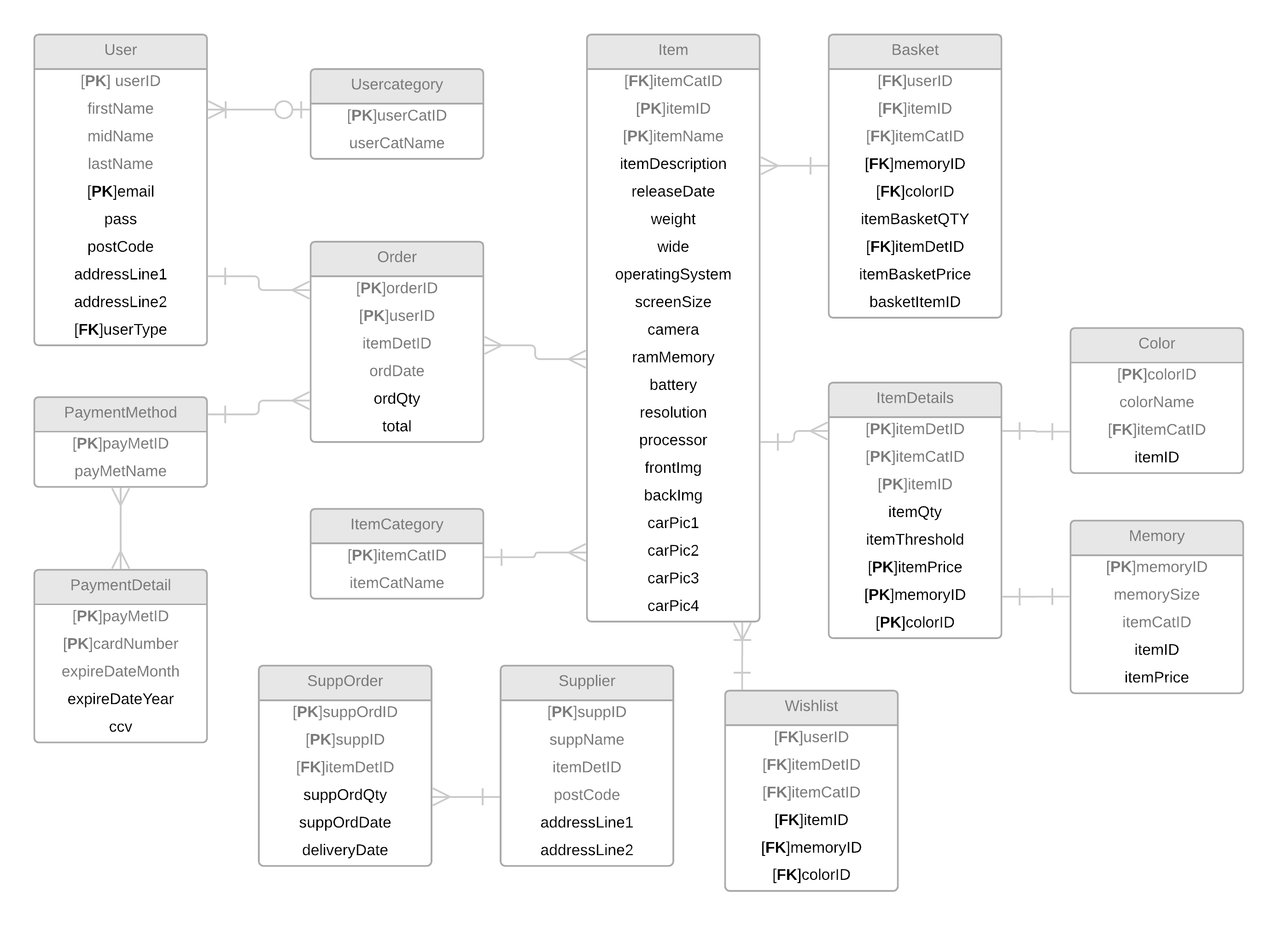
ER Diagram

Slide 6
Site Map
Homepage
Shop
Add To Basket
Login Page
Registration Page
Basket
Remove Items
Checkout Page
Successful Payment
Denied Payment
Account Page
By Category
Specific Item
Whishlist
Contact Us

Slide 7

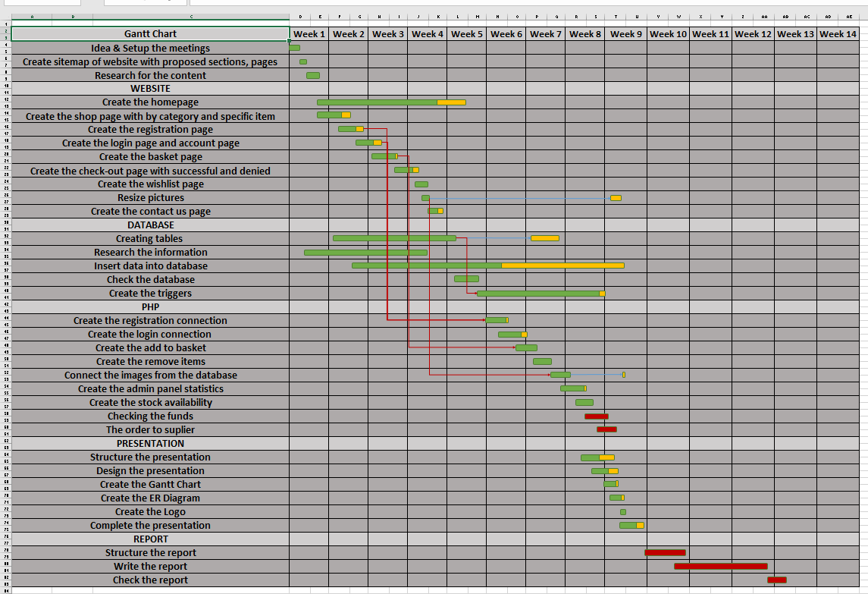
Gantt chart
&
Task dependency

Slide 8
Questions?

